Slide 1

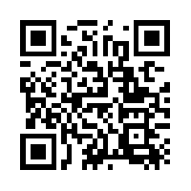
Quantum Communications Group
KML - security measures
Group Coordinator:
Armando Nolasco Pinto
anp@ua.pt
Group Websites:
https://www.it.pt/Groups/Index/72
LinkedIn: https://www.linkedin.com/company/quantum-communications-group-it-av/
Diogo Matos

Slide 2
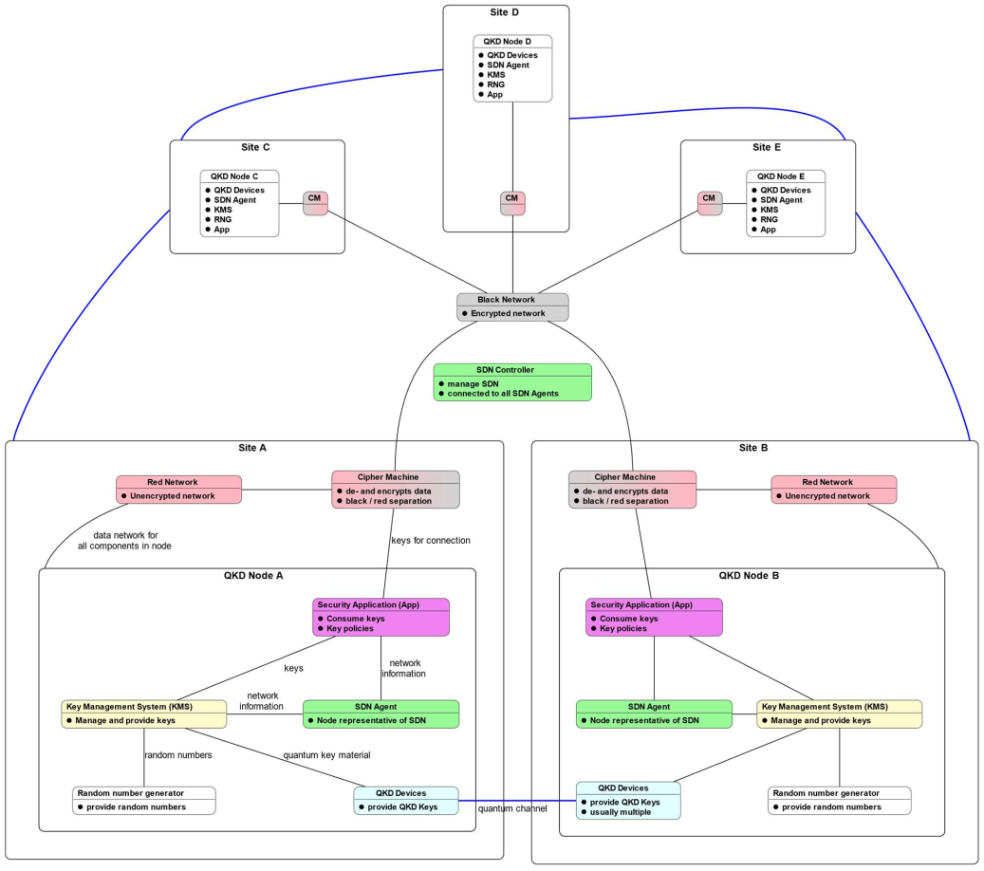
Red & black networks
Communication security inside node or site can be soften;
Any other communication (except the ones using the quantum channel) pass through the black network;
A secure way to authenticate devices/entities/messages and to share keys is needed;
The use of post-quantum algorithms (PQA), when possible and viable, must be used.

Slide 3
Device/app identification and authentication
Each device need to be identified by a certificate (X.509) chain. It includes all certificates from a trusted root certificate authority (CA) certificate, these certificates chains are linked to a device-specific leaf certificate. The certificate must have PQC support.
Authentication process:
1 - request certificate and verify it;
2 - send a challenge (nonce) to be signed and verify the signature.
Algorithms:
Digital signature - Falcon-512 / Dilithium 2 (or 3) (both in NIST’s 1st four quantum-resistant algorithms announcement)

Slide 4

Token based authentication
A token is generated after authentication for a specific ‘user’. That token can be used multiple times during a period of time and gives authorization to access a specific set of services/data.
This can be used, for example, between the secure apps and KMS api. This way the api doesn’t need to worry about authentication and authorization, only need to ask the auth server for verification of the token.
There is two big options OAuth and JWT. Since this will most likely be used in a private network, JWT it’s a better suit, it’s stateless, lightweight and doesn’t require the development and deploy of a complex authentication system.
Specially interesting for the interface specified in ETSI GS QKD 014

Slide 5
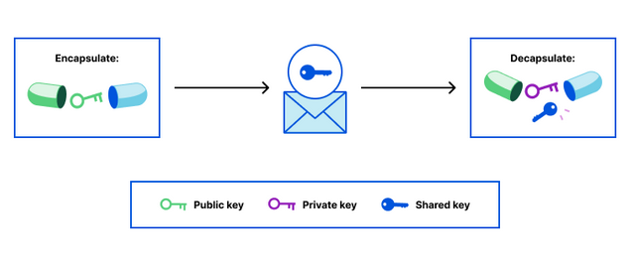
Key exchange
Since algorithms like Deffie-Helman’s don’t provide security against a quantum adversary, post-quantum key encapsulation algorithms (most of them relying on the Learning With Errors mathematical problem) can be used alongside authentication based on trust algorithms. Being able to use fast secure symmetric cryptography and relying on symmetric cryptography in order to transmit safely a shared key.
Algorithms like FrodoKEM or Crystals Kyber (NIST certified) can be used.

Slide 6
TLS
TLS is one of the most used cryptographic algorithms providing authentication and a session between two entities.
TLS 1.3 has both quantum-safe authentication and quantum-safe key exchange.
While there are no vulnerabilities known in any of the quantum-safe algorithms used, while NIST don’t finish the standards on PQC. Right now it is advised to use hybrid (quantum-safe + RSA/elliptic curve).
OpenSSL has an open-source implementation of the algorithm.

Slide 7
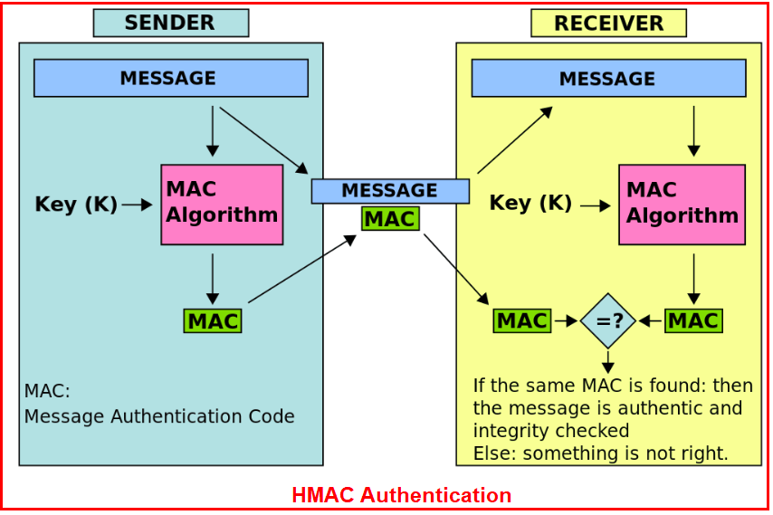
Message integrity - MAC
Each message should be accompanied with a MAC in order to make sure the message was not changed during transmission;
HMAC, Wegnar Carter (VMAC, UMAC e.g) authentication can be used.
Secret keys that might be needed for these algorithm can be generated using a key derivation function on the key used to cipher messages

Slide 8
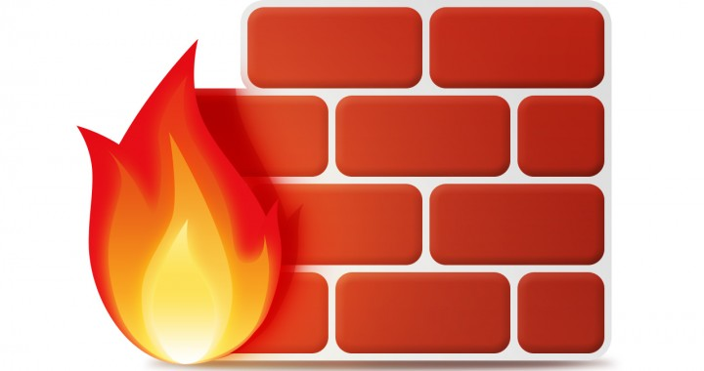
Other security measures
The KMS and other systems located inside a secure location with a proper network segregation and segmentation are already below, to a certain degree, a security layer. But is never enough and other security measure must be taken.
Endpoint / server security:
Firewall - blocking ports, protocols, etc;
Access control;
Logging - traceability is key;
SSD/HDD hardware data encryption;
Services with encrypted data(bases);
Backup plan - preserve most sensible data;
Endpoint detection and response - intrusion detection, incident response, and forensics.

Slide 9
References
2022, Yao, Post Quantum Design in SPDM for Device Authentication and Key Establishment
2022, Tamvada, Deep dive into a post-quantum key encapsulation algorithm
1981, Wegman, New hash functions and their use in authentication and set equality
2013, Abidin, Direct Proof of Security of Wegman-Carter Authentication with Partially Known Key

Slide 10
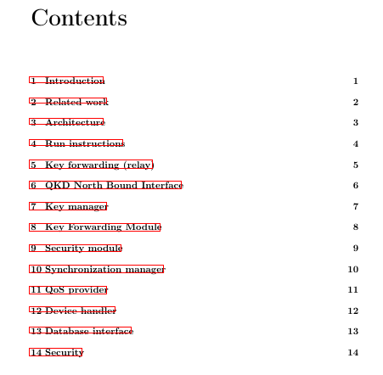
KML documentation

